Slide 1
THE CENTRAL LIMIT THEOREM
The “World is Normal” Theorem

Slide 2
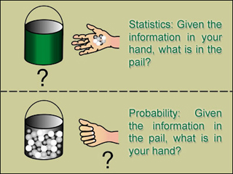
Probability:
Statistics:
From population to sample (deduction)
From sample to the population (induction)

Slide 3
Sampling Distributions
Population parameter: a numerical descriptive measure of a population.
(for example: μ, σ , p (a population proportion); the numerical value of a population parameter is usually not known)
Examples: μ = mean height of all NCSU students
Sample statistic: a numerical descriptive measure calculated from sample data.
(e.g, x, s, p (sample proportion))

Slide 4
Parameters; Statistics
In real life parameters of populations are unknown and unknowable.
For example, the mean height of US adult (18+) men is unknown and unknowable
Rather than investigating the whole population, we take a sample, calculate a statistic related to the parameter of interest, and make an inference.
The sampling distribution of the statistic tells us how the value of the statistic varies from sample to sample.

Slide 5
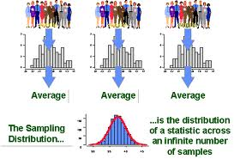
DEFINITION: Sampling Distribution
The sampling distribution of a sample statistic calculated from a sample of n measurements is the probability distribution of values taken by the statistic in all possible samples of size n taken from the same population.
Based on all possible samples of size n.

Slide 6
Constructing a Sampling Distribution
In some cases the sampling distribution can be determined exactly.
In other cases it must be approximated by using a computer to draw some of the possible samples of size n and drawing a histogram.

Slide 7
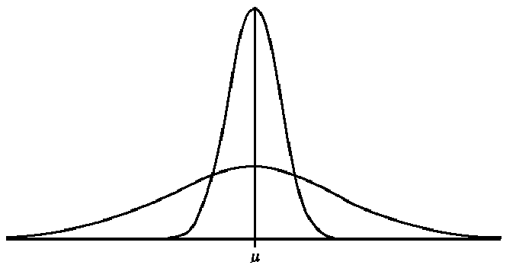
Sampling Distribution of Normally Distributed Population
If the population is normally distributed, then the sampling distribution of x is normally distributed for any sample size n.
Sampling distribution of x:
N(μ , σ /√10)
n=10
σ/√10
Population distribution:
N(μ , σ)
σ

Slide 8
Non-normal Populations
What can we say about the shape of the sampling distribution of x when the population from which the sample is selected is not normal?

Slide 9
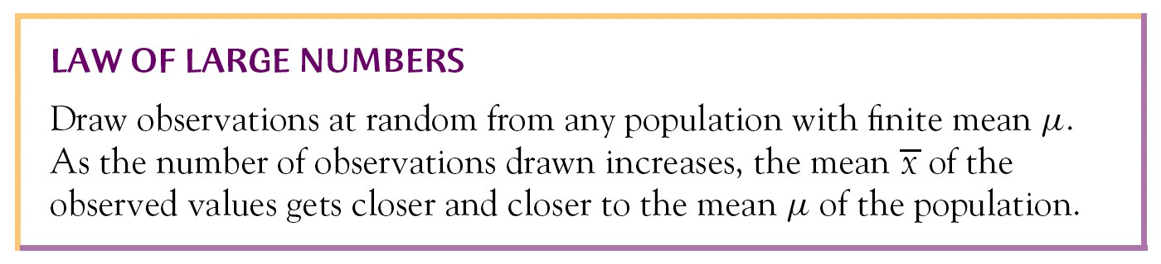
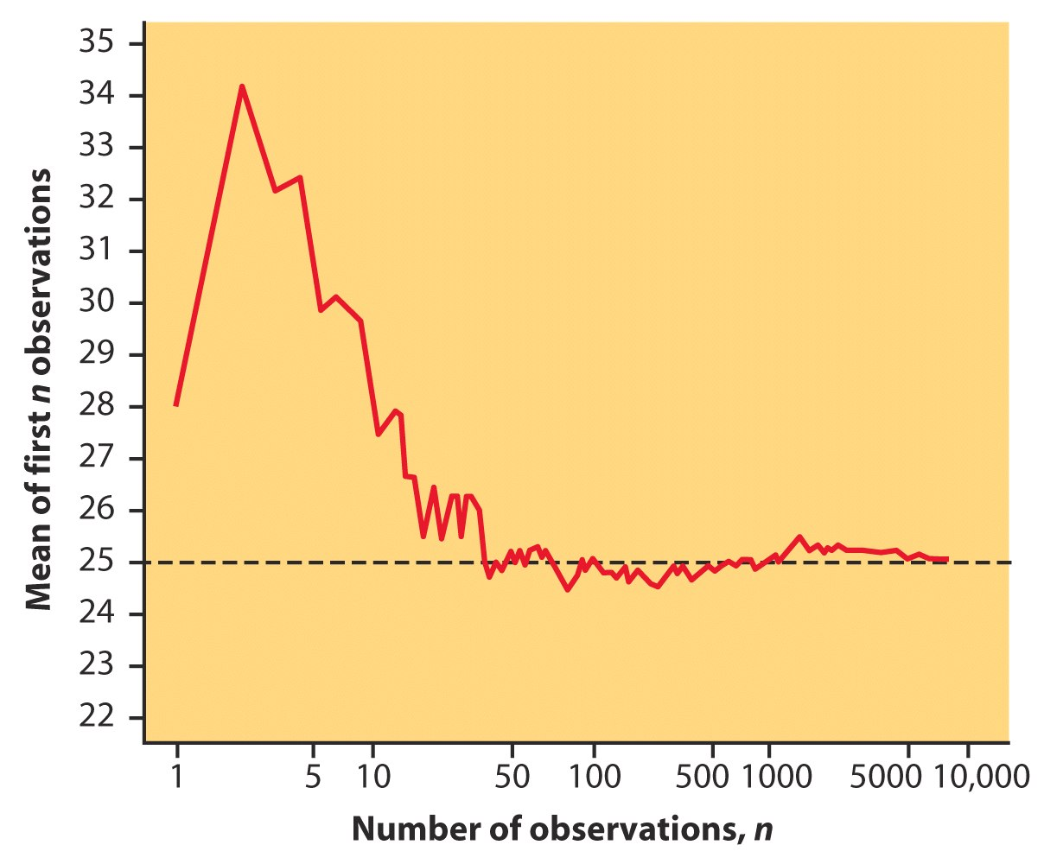
Law of Large Numbers
This figure shows results from an experiment that demonstrates the law of large numbers.

Slide 10
The Central Limit Theorem (for the sample mean x)
If a random sample of n observations is selected from a population (any population), then when n is sufficiently large, the sampling distribution of x will be approximately normal.
(The larger the sample size, the better will be the normal approximation to the sampling distribution of x.)

Slide 11
The Importance of the Central Limit Theorem
When we select simple random samples of size n, the sample means will vary from sample to sample. We can model the distribution of these sample means with a probability model that is …

Slide 12
How Large Should n Be?
For the purpose of applying the Central Limit Theorem, we will consider a sample size to be large when n > 30.
←
←
←
Even if the population from which the sample is selected looks like this …
… the Central Limit Theorem tells us that a good model for the sampling distribution of the sample mean x is …
→
→
→

Slide 13
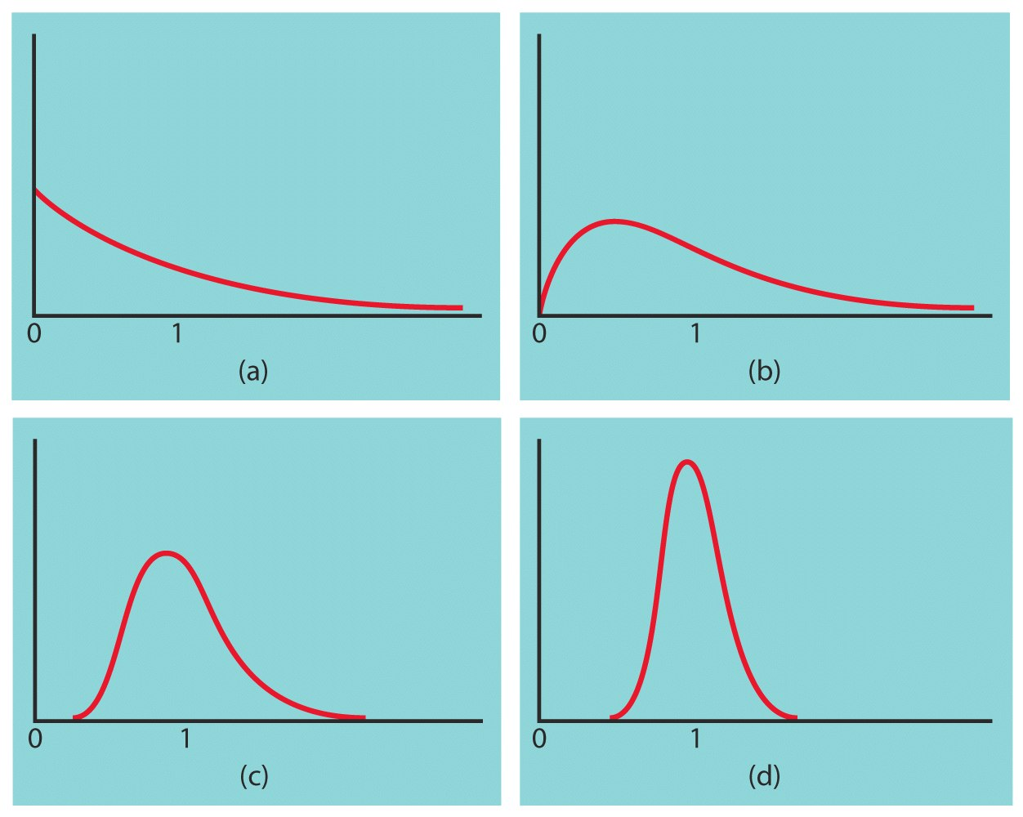
Central Limit Theorem Time to Complete Activity
These figures illustrate the sampling distributions of x-bars based on
n = 1
n = 10
n = 20
n = 70

Slide 14
Summary
Population: mean μ; stand dev. σ; shape of population dist. is unknown; value of μ is unknown; select random sample of size n;
Sampling distribution of x:
mean x-bar; stand. dev. σ/√n;
always true!
By the Central Limit Theorem:
the shape of the sampling distribution is approx. normal, that is
x ~ N(μ, σ/√n)

